Slide 1


Slide 2

OUR GUIDING PHILOSOPHY

Slide 3
Special classes were organized for growing girls & their mothers at Sankalp-A Pledge To Change NIT and Mohan Nagar centres.

Slide 4
A NOBLE INITIATIVE FROM SANKALP GIRLD AND THEIR MOTHERS
Physical/Sex education has always been an ignored area in the school curriculum of any board in India
We at Sankalp believe that our centres should actually function as transformation centres addressing issues from education to livelihood ,from women empowerment adolescent girls awareness sessions on physical education
In line with our mission, the first session focussing on physical education of girls was organized on 11 th January at NIT and Mohan Nagar Centres.

Slide 5
SENSITIVE ISSUES ADDRESSED BY SANKALP TEAM
Negative and positive touch
· Understanding their body when they reach puberty
· Periods (since most of the girls in poor families use cloth and pads are not affordable, they were taught how to properly use cloth like regular washing drying etc)
· Wearing proper innerwear’s for girls reaching puberty
· Self defense
· Communicating their problems to ones parents
· Talking about their personal issues like someone following trying on or getting physical
· Right age to get married or have physical relationships
· There are teachers in school who tries to misuse girls body in many ways which they should learn to identify
· Comfortable and disgusting touch
· Protected sex and about AIDS
· Awareness towards cyber crime and misuse of personal videos and photos

Slide 6
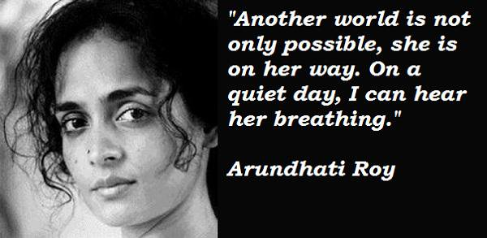

Slide 7
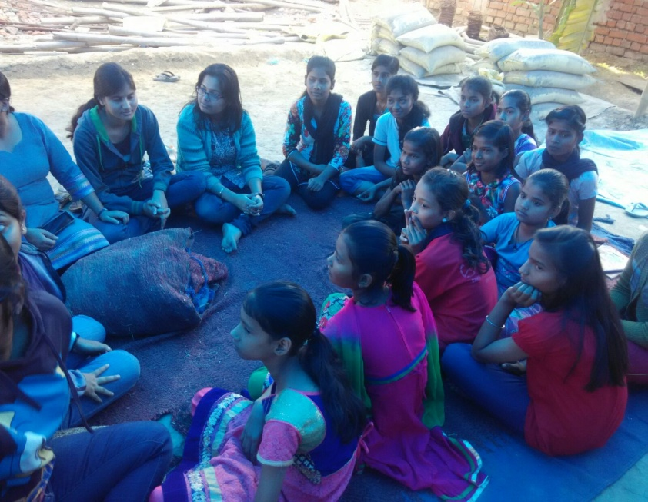
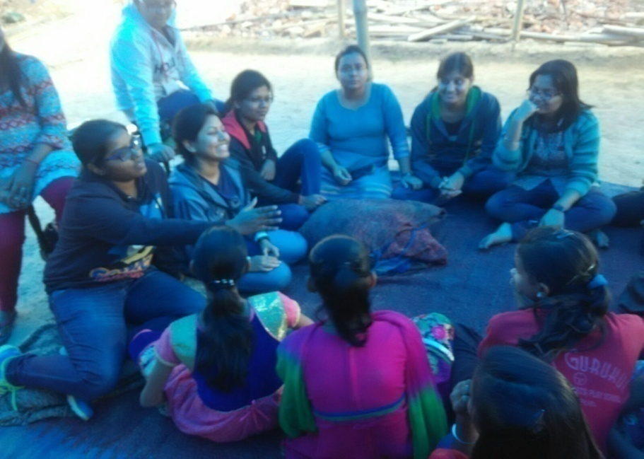
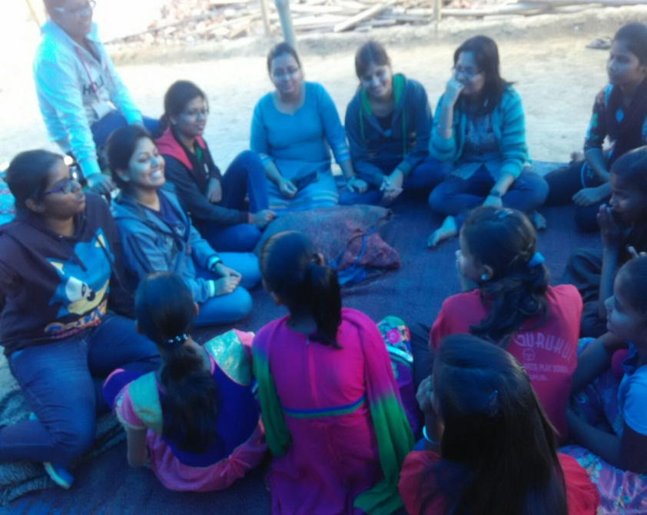
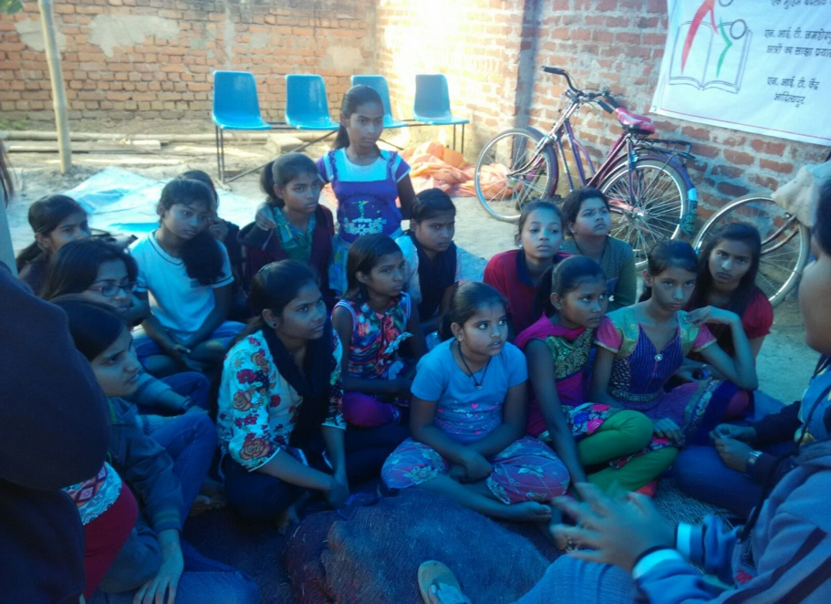
THE TEAM WITH A MISSION

Slide 8


Slide 9
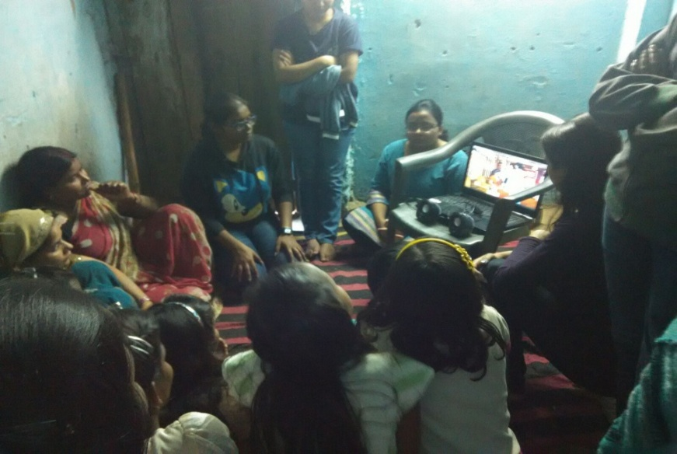
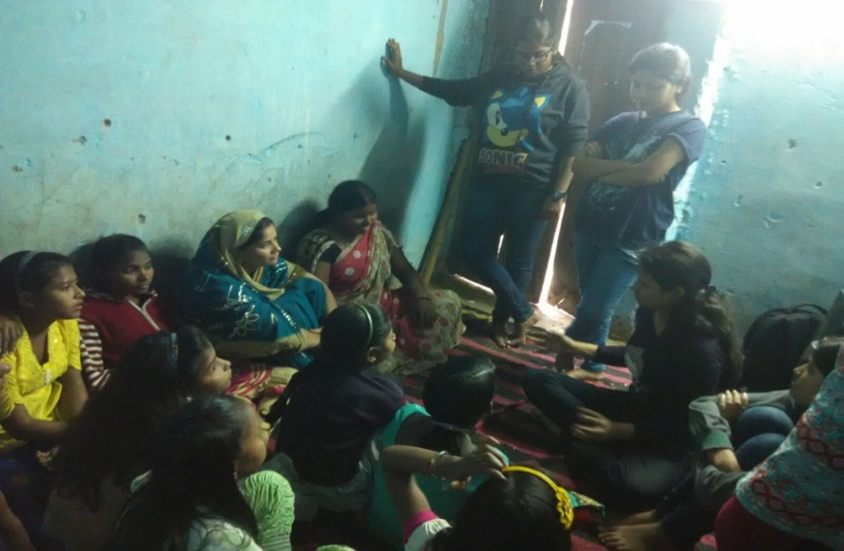
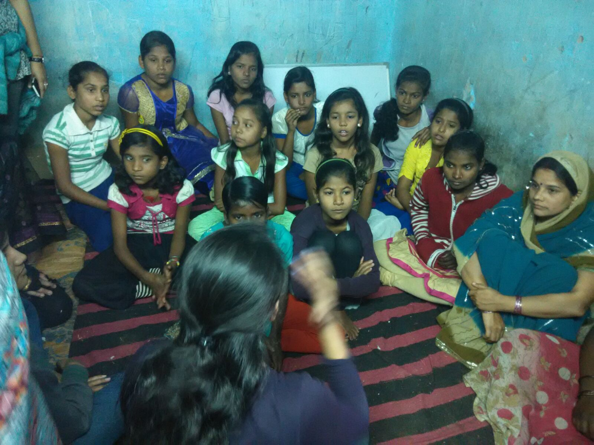
SANKALP GIRLS TEAM
LEADING FROM THE FRONT

Slide 10


Slide 11

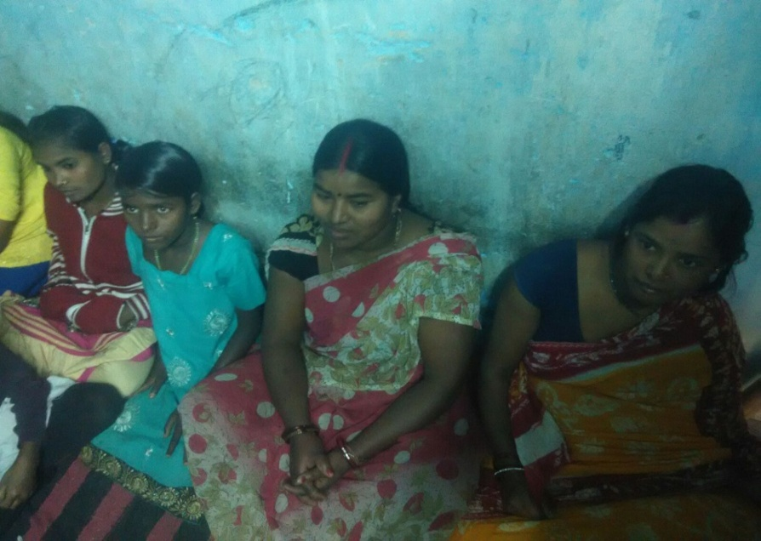
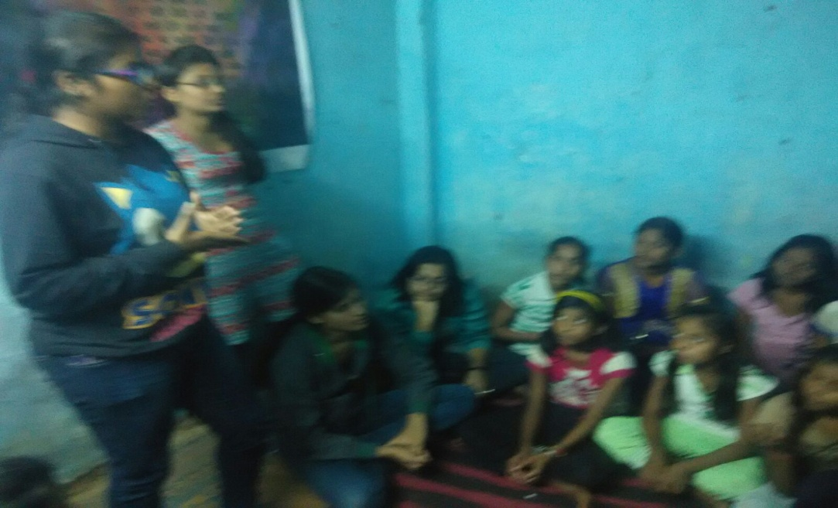
Change is going to happen and NOW is the time

Slide 12


Slide 13

The future we hope to build !!!

Slide 14


Slide 15
"Change will not come if we wait for some other person or some other time. We are the ones we've been waiting for. We are the change that we seek.“

Slide 16
COME BE A PART OF THE JOURNEY
You can donate at any our centres by just making a call to Sankalp-A Pledge to Change volunteers.
All our centres run 6 days a week
You may donate books from
  Class 1-8- Course Text Books (Any Board)
  Story Books
  Unused stationery
  Any other items like bag, toys, uniforms etc.
Relevant Contact Nos. Are
  Subodh Kumar Das-9798756336
  Mayank Aggarwal -9031975746
  Suresh Pareek -7209632032
  Vikas Dixit -9472706225

Slide 17
ACCOUNT DETAILS FOR SUPPORT
Sankalp Account Details
  You can transfer funds online into our account:-
  “SANKALP” A/C No.-31114719936
  CIF No: 85757412911
  IFSC Code: SBIN0001882
  MICR Code: 831002004
  Branch code: (1882)
  Branch: SBI- RIT JAMSHEDPUR
    You may also visit our website and pay through online link available over it.
www.sankalpnitjamshedpur.org

Slide 18
“You have not lived today until you have done something for someone who can never repay you.”
www.sankalpnitjamshedpur.org

